Slide 1
Lecture 8: Backpropagation for Neural Networks
Instructor: Yang Xu

Slide 2
Outline
Activation functions
Derivatives
Backpropagation

Slide 3
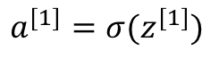
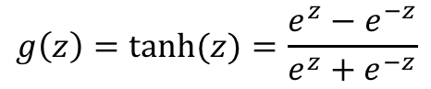
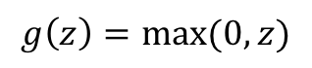
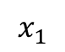
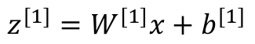
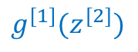
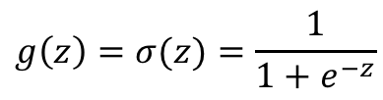
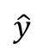
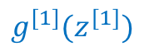
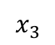
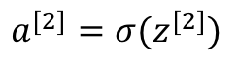
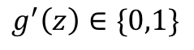
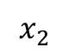
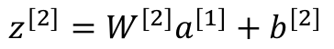
Activation functions
Sigmoid
$$g\left(z\right)=σ(z)=\frac{1}{1+e^{−z}}$$
$$x_{1}$$
$$x_{2}$$
$$\hat{y}$$
$$g\left(z\right)=\text{tanh}(z)=\frac{e^{z}−e^{−z}}{e^{z}+e^{−z}}$$
$$x_{3}$$
“hyperbolic tangent”. Almost always works better for hidden layers than sigmoid.
Single input example x
Downside for both: small gradient for extreme z values
$$z^{[1]}=W^{[1]}x+b^{[1]}$$
$$a^{[1]}=σ(z^{[1]})$$
$$g^{[1]}(z^{[1]})$$
Rectified linear unit (ReLU)
$$z^{[2]}=W^{[2]}a^{[1]}+b^{[2]}$$
$$g\left(z\right)=max⁡(0,z)$$
$$a^{[2]}=σ(z^{[2]})$$
$$g^{[1]}(z^{[2]})$$
$$g^{′}\left(z\right)∈\{0,1\}$$

Slide 4
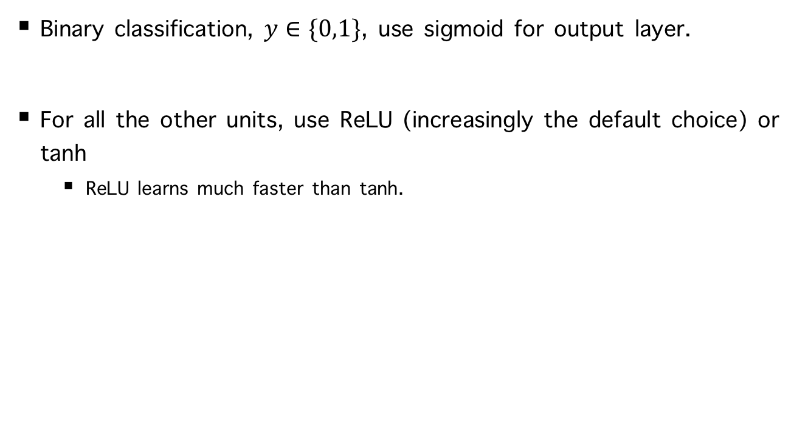
Rule-of-thumb for choosing activation functions
Binary classification, $y∈\{0,1\}$, use sigmoid for output layer.
For all the other units, use ReLU (increasingly the default choice) or tanh
ReLU learns much faster than tanh.

Slide 5
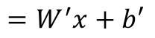
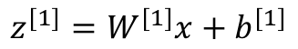
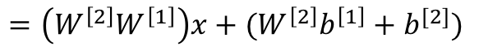
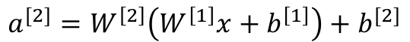
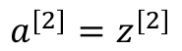
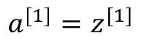
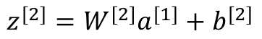
Why do we need activation functions?
Why not linear activation?
$$z^{[1]}=W^{[1]}x+b^{[1]}$$
$$a^{[2]}=W^{\left[2\right]}\left(W^{\left[1\right]}x+b^{\left[1\right]}\right)+b^{[2]}$$
$$a^{[1]}=z^{[1]}$$
$$=\left(W^{\left[2\right]}W^{\left[1\right]}\right)x+(W^{\left[2\right]}b^{\left[1\right]}+b^{[2]})$$
$$z^{[2]}=W^{[2]}a^{[1]}+b^{[2]}$$
$$=W^{′}x+b′$$
$$a^{[2]}=z^{[2]}$$
If linear activation used in hidden layer, it is no more expressive than a standard logistic regression
$$x_{1}$$
$$x_{2}$$
$$\hat{y}$$
$$x_{3}$$
Linear activation can be used at output layer as a regression model

Slide 6
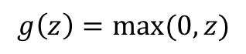
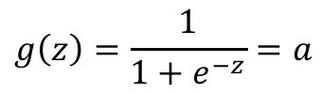
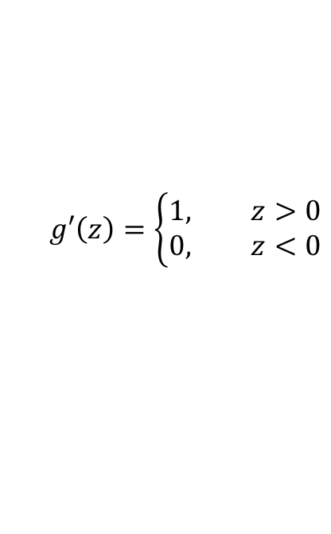
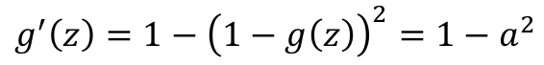
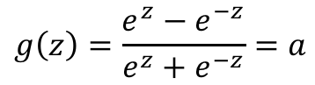
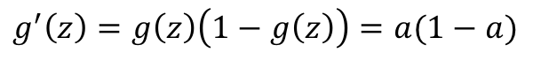
Derivatives of activation functions
Sigmoid
$$g\left(z\right)=\frac{1}{1+e^{−z}}=a$$
$$g^{′}\left(z\right)=g\left(z\right)\left(1−g\left(z\right)\right)=a(1−a)$$
Tanh
$$g\left(z\right)=\frac{e^{z}−e^{−z}}{e^{z}+e^{−z}}=a$$
$$g^{′}\left(z\right)=1−{\left(1−g\left(z\right)\right)}^{2}=1−a^{2}$$
ReLU
$$g\left(z\right)=max⁡(0,z)$$
$$g′\left(z\right)=\left\{\begin{aligned}1, z>0 \\ 0, z<0\end{aligned}\right.$$

Slide 7
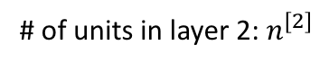
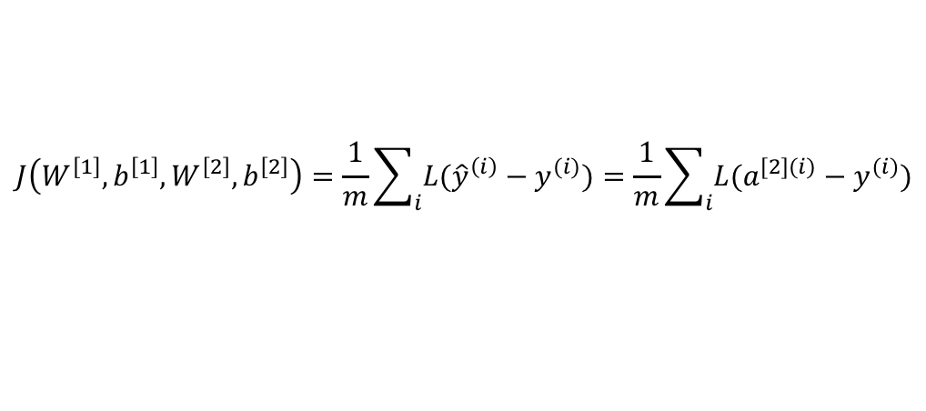
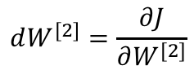
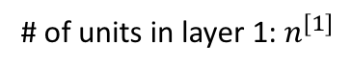
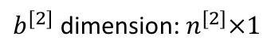
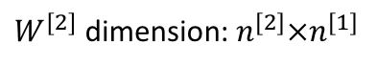
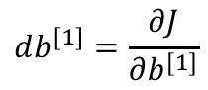
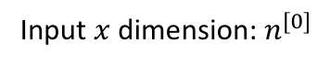
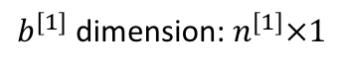

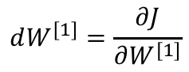
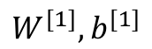
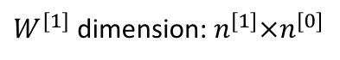
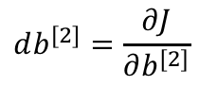
Gradient descent for neural networks
Input $x$ dimension: $n^{[0]}$
$$x_{1}$$
# of units in layer 1: $n^{[1]}$
# of units in layer 2: $n^{[2]}$
$$x_{2}$$
$$\hat{y}$$
$b^{[1]}$ dimension: $n^{[1]}×1$
$W^{[1]}$ dimension: $n^{[1]}×n^{[0]}$
$$x_{3}$$
$W^{[2]}$ dimension: $n^{[2]}×n^{[1]}$
$b^{[2]}$ dimension: $n^{[2]}×1$
$$W^{[2]},b^{[2]}$$
Binary classification case
$$W^{[1]},b^{[1]}$$
$$J\left(W^{\left[1\right]},b^{\left[1\right]},W^{\left[2\right]},b^{\left[2\right]}\right)=\frac{1}{m}\sum_{i}{L({\hat{y}}^{\left(i\right)}−y^{(i)})}=\frac{1}{m}\sum_{i}{L(a^{[2](i)}−y^{(i)})}$$
$$dW^{[1]}=\frac{∂J}{∂W^{[1]}}$$
$$db^{[1]}=\frac{∂J}{∂b^{[1]}}$$
$$dW^{[2]}=\frac{∂J}{∂W^{[2]}}$$
$$db^{[2]}=\frac{∂J}{∂b^{[2]}}$$
How to compute the gradients (derivatives)?

Slide 8
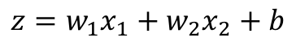
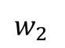
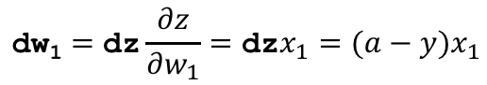
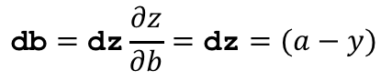
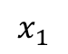
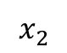
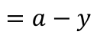
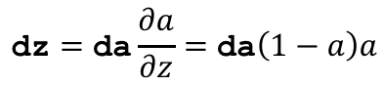
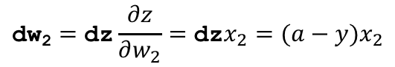







Backpropagation
Recap of logistic regression
$$L\left(a,y\right)=−(y\log{(a)}+\left(1−y\right)\log{(1−a)})$$
$$\text{dw}\text{1}=\text{dz}\frac{∂z}{∂w_{1}}=\text{dz}x_{1}=(a−y)x_{1}$$
$$\text{dw}\text{2}=\text{dz}\frac{∂z}{∂w_{2}}=\text{dz}x_{2}=(a−y)x_{2}$$
$$\text{dw}\text{ =} \text{dz}x$$
$$\text{db}=\text{dz}$$
$$x_{1}$$
$$\text{d}\text{b}=\text{dz}\frac{∂z}{∂b}=\text{dz}=(a−y)$$
$$w_{1}$$
$$x_{2}$$
$$z=w_{1}x_{1}+w_{2}x_{2}+b$$
$$a=σ\left(z\right)$$
$$L\left(a,y\right)$$
$$w_{2}$$
$$\text{dz}=\text{da}\frac{∂a}{∂z}=\text{da}\left(1−a\right)a$$
$$\text{da}=\frac{∂L}{∂a}=−\frac{y}{a}+\frac{1−y}{1−a}$$
$$b$$
$$=a−y$$

Slide 9











































Backpropagation (two-layer neural network)
$${\text{d}W}^{[1]}={\text{dz}}^{[1]}\frac{∂z^{[1]}}{∂W^{[1]}}={\text{dz}}^{\left[1\right]}x^{T}$$
$${\text{d}\text{b}}^{[1]}={\text{dz}}^{[1]}\frac{∂z^{[1]}}{∂b^{[1]}}={\text{dz}}^{[1]}$$
$$W^{[2]}$$
$${\text{d}W}^{[2]}\text{ =}{\text{dz}}^{[2]}{\text{a}}^{[1]}?$$
$${\text{d}W}^{[2]}\text{ =}{\text{dz}}^{[2]}{\text{a}}^{\left[1\right]T}$$
$$b^{[2]}$$
$${\text{db}}^{[2]}={\text{dz}}^{[2]}$$
$$X$$
$$W^{[1]}$$
$$z^{[1]}=W^{[1]}x+b^{[1]}$$
$$a^{[1]}=g(z^{[1]})$$
$$z^{[2]}=W^{[2]}a^{[1]}+b^{[2]}$$
$$a^{[2]}=σ(z^{[2]})$$
$$L\left(a^{[2]},y\right)$$
$$b^{[1]}$$
$${\text{dz}}^{[1]}={\text{da}}^{[1] }∗\frac{∂a^{[1]}}{∂z^{[1]}}$$
$${\text{da}}^{[1]}={\text{dz}}^{[2]}\frac{∂z^{[2]}}{∂a^{[1]}}$$
$${\text{dz}}^{[2]}=a^{[2]}−y$$
$${\text{da}}^{[2]}=\frac{∂L}{∂a^{[2]}}=−\frac{y}{a^{[2]}}+\frac{1−y}{1−a^{[2]}}$$
$$=W^{\left[2\right]T}{\text{dz}}^{[2]}∗g′(z^{[1]})$$
$$=W^{\left[2\right]T}{\text{dz}}^{[2]}$$
$$4×1$$
$$\frac{∂z^{[2]}}{∂W^{[2]}}=\frac{∂z^{[2]}}{∂w^{[2]}}=a^{\left[1\right]T}$$
$${\text{d}\text{z}}_{1}^{[1]}$$
$${\text{da}}_{1}^{[1]}$$
$$1×4$$
$$x_{1}$$
${\text{d}W}^{[2]}$ is the same dimension as $W^{[2]}$
$${\text{d}\text{z}}_{2}^{[1]}$$
$${\text{da}}_{2}^{[1]}$$
$${\text{dz}}^{[2]}$$
$${\text{da}}^{[2]}$$
$$\frac{∂z^{[2]}}{∂a^{[1]}}=W^{\left[2\right]T}$$
$$x_{2}$$
$${\text{d}\text{z}}_{3}^{[1]}$$
$${\text{da}}_{3}^{[1]}$$
$$\hat{y}$$
${\text{da}}^{[1]}$is the same dimension as $a^{[1]}$
$$x_{3}$$
$${\text{d}W}^{[2]}$$
$\frac{∂a^{[1]}}{∂z^{[1]}}=g′(z^{[1]})$, form depends on activation function chosen
$${\text{d}\text{z}}_{4}^{[1]}$$
$${\text{da}}_{4}^{[1]}$$
$${\text{dz}}^{[2]}$$
$${\text{d}W}^{[1]}$$
Element-wise multiply because ${\text{dz}}^{[1]}$ and ${\text{da}}^{[1] }$ are same dimension
$${\text{dz}}^{[1]}$$

Slide 10



















Derivatives w.r.t. matrix
Input to hidden
$$\frac{∂z^{[1]}}{∂W^{[1]}}$$
$$z^{[1]}=W^{[1]}x+b^{[1]}$$
In order to compute ${\text{d}W}^{[1]}$, need to know
How?
The partial derivatives of each component of $z^{[1]}$ w.r.t. each element of $W^{[1]}$
($b^{[1]}$ ignored)
Same shape as $W^{[1]}$
$$\frac{∂z_{1}^{[1]}}{∂W_{11}}=x_{1}$$
$$\frac{∂z_{1}^{[1]}}{∂W_{12}}=x_{2}$$
$$\frac{∂z_{1}^{[1]}}{∂W_{13}}=x_{3}$$
$${\text{d}W}^{[1]}={\text{dz}}^{[1]}\frac{∂z^{[1]}}{∂W^{[1]}}=$$
$$\frac{∂z_{2}^{[1]}}{∂W_{21}}=x_{1}$$
$$\frac{∂z_{2}^{[1]}}{∂W_{22}}=x_{2}$$
$$\frac{∂z_{2}^{[1]}}{∂W_{23}}=x_{3}$$
$$\frac{∂z_{3}^{[1]}}{∂W_{31}}=x_{1}$$
$$\frac{∂z_{3}^{[1]}}{∂W_{32}}=x_{2}$$
$$\frac{∂z_{3}^{[1]}}{∂W_{33}}=x_{3}$$
$$\frac{∂z_{4}^{[1]}}{∂W_{41}}=x_{1}$$
$$\frac{∂z_{4}^{[1]}}{∂W_{42}}=x_{2}$$
$$\frac{∂z_{4}^{[1]}}{∂W_{43}}=x_{3}$$
$$={\text{dz}}^{[1]}x^{T}$$

Slide 11














Derivatives w.r.t. matrix (cont.)
Hidden to output
Want to know ${dW}^{[2]}$
Need to compute $\frac{∂z^{[2]}}{∂W^{[2]}}$
$$z^{[2]}=W^{[2]}a^{[1]}+b^{[2]}$$
When output layer has 1 node
$$\frac{∂z^{[2]}}{∂W^{[2]}}=\left[a_{1}^{\left[1\right]},a_{2}^{\left[2\right]},a_{3}^{\left[3\right]},a_{4}^{\left[4\right]}\right]=a^{\left[1\right]T}$$
$${\text{d}W}^{\left[2\right]}=dz^{[2]}a^{\left[1\right]T}$$
When output layer has 2 node
$$\frac{∂z^{[2]}}{∂W^{[2]}}=\left[\begin{aligned}a_{1}^{\left[1\right]} \\ a_{1}^{\left[1\right]}\end{aligned}\begin{matrix}a_{2}^{\left[2\right]} \\ a_{2}^{\left[2\right]}\end{matrix}\begin{matrix}a_{3}^{\left[3\right]} \\ a_{3}^{\left[3\right]}\end{matrix}\begin{matrix}a_{4}^{\left[4\right]} \\ a_{4}^{\left[4\right]}\end{matrix}\right]=a^{\left[1\right]T}$$
$${\text{d}W}^{\left[2\right]}=dz^{[2]}a^{\left[1\right]T}$$
$$a_{1}^{[1]}$$
$$x_{1}$$
General principle
$$a_{2}^{[1]}$$
$${dz}_{1}^{[1]}$$
$$x_{2}$$
$${\text{d}W}^{\left[l\right]}=dz^{[l]}a^{\left[l−1\right]T}$$
$$a_{3}^{[1]}$$
$${dz}_{2}^{[1]}$$
$$x_{3}$$
$$a_{4}^{[1]}$$

Slide 12




















Derivatives w.r.t. vector
Hidden to output
Want to know ${da}^{[1]}$
Need to compute $\frac{∂z^{[2]}}{∂a^{[1]}}$
$$z^{[2]}=W^{[2]}a^{[1]}+b^{[2]}$$
$$\frac{∂z^{[2]}}{∂a^{[1]}}=\left[\begin{aligned}W_{1}^{[2]} \\ W_{1}^{[2]} \\ W_{1}^{[2]} \\ W_{1}^{[2]}\end{aligned}\right]=W^{\left[2\right]T}$$
When output layer has 1 node
$${da}^{[1]}=W^{\left[2\right]T}{dz}^{[2]}$$
When output layer has 2 node
$\frac{∂z^{[2]}}{∂a^{[1]}}$ is the partial derivatives of each component of $z^{[2]}$ w.r.t. each component of $a^{[1]}$
$\frac{∂}{∂a_{1}^{[1]}}$ associated with column 1
$$\frac{∂z_{1}^{[2]}}{∂a_{1}^{[1]}}=W_{11}^{[2]}$$
$$\frac{∂z_{1}^{[2]}}{∂a_{2}^{[1]}}=W_{12}^{[2]}$$
$$\frac{∂z_{1}^{[2]}}{∂a_{3}^{[1]}}=W_{13}^{[2]}$$
$$\frac{∂z_{1}^{[2]}}{∂a_{3}^{[1]}}=W_{14}^{[2]}$$
$\frac{∂}{∂a_{2}^{[1]}}$ associated with column 2
$\frac{∂z^{[2]}}{∂a^{[1]}}=W^{[2]}$ itself!
$$\frac{∂z_{2}^{[2]}}{∂a_{1}^{[1]}}=W_{21}^{[2]}$$
$$\frac{∂z_{2}^{[2]}}{∂a_{2}^{[1]}}=W_{21}^{[2]}$$
$$\frac{∂z_{2}^{[2]}}{∂a_{3}^{[1]}}=W_{23}^{[2]}$$
$$\frac{∂z_{2}^{[2]}}{∂a_{3}^{[1]}}=W_{24}^{[2]}$$
$\frac{∂}{∂a_{3}^{[1]}}$ associated with column 3
$\frac{∂}{∂a_{4}^{[1]}}$ associated with column 4
$${da}^{[1]}=$$
$$=W^{\left[2\right]T}{dz}^{[2]}$$

Slide 13

























General computing principles
$$z^{[l+1]}=W^{[l+1]}a^{[l]}+b^{[l+1]}$$
$W^{[l+1]}$ : $n^{[l+1]}×n^{[l]}$, $b^{[l+1]}$ : $n^{[l+1]}×1$
$${dz}_{1}^{[l]}$$
$$n^{[l+1]}×n^{[l]}$$
$$n^{[l+1]}×1$$
$$1×n^{[l+1]}$$
$${da}_{1}^{[l]}$$
$${dW}^{[l+1]}={dz}^{[l+1]}a^{\left[l\right]T}$$
$${dz}_{1}^{[l+1]}$$
$${dz}_{2}^{[l]}$$
$${db}^{[l+1]}={dz}^{[l+1]}$$
$${da}_{2}^{[l]}$$
$${dz}_{3}^{[l]}$$
$${dz}_{2}^{[l+1]}$$
$$n^{[l]}×1$$
$$n^{[l]}×n^{[l+1]}$$
$$n^{[l+1]}×1$$
$${da}_{3}^{[l]}$$
$${da}^{[l]}=W^{\left[l+1\right]T}{dz}^{\left[l+1\right]}$$
Usually combined
$${dz}_{4}^{[l]}$$
$${dz}_{3}^{[l+1]}$$
$${dz}^{\left[l\right]}={da}^{\left[l\right]}∗g^{′}\left(z^{\left[l\right]}\right)=W^{\left[l+1\right]T}{dz}^{\left[l+1\right]}∗g^{′}\left(z^{\left[l\right]}\right)$$
$${da}_{4}^{[l]}$$
$$n^{[l+1]}$$
$$n^{[l]}$$
${dz}^{\left[l\right]}$ is then passed to layer $l−1$ to compute ${dW}^{[l]}$ and ${db}^{[l]}$

Slide 14






















Understanding backprop
$W_{ij}^{[l]}$ connects the $j$th unit in layer $l$ to the $i$th unit in layer $l+1$
$$a_{1}^{[1]}$$
$$W_{11}^{[2]}$$
$$z_{1}^{[2]}=W_{11}^{[2]}a_{1}^{[1]}+W_{12}^{[2]}a_{2}^{[1]}+W_{13}^{[2]}a_{3}^{[1]}+W_{14}^{[2]}a_{4}^{[1]}$$
$$W_{12}^{[2]}$$
$${dz}_{1}^{[2]}$$
$$a_{2}^{[1]}$$
$$\left[\begin{matrix}dW_{11}^{[2]} \\ \\ \end{matrix}\begin{matrix}dW_{12}^{[2]} \\ \\ \end{matrix}\begin{matrix}dW_{13}^{[2]} \\ \\ \end{matrix}\begin{matrix}dW_{14}^{[2]} \\ \\ \end{matrix}\right]=\left[\begin{matrix}{dz}_{1}^{[2]} \\ \\ \end{matrix}\right][a_{1}^{\left[1\right]}a_{2}^{\left[1\right]}a_{3}^{\left[1\right]}a_{4}^{[1]}]$$
$$W_{13}^{[2]}$$
$$a_{3}^{[1]}$$
$$W_{14}^{[2]}$$
$$a_{4}^{[1]}$$
$${dW}^{[2]}={dz}^{[2]}a^{\left[1\right]T}$$
$${da}_{1}^{[1]}$$
$$W_{11}^{[2]}$$
$${da}_{1}^{[1]}=W_{11}^{[2]}{dz}_{1}^{[2]}+W_{21}^{[2]}{dz}_{2}^{[2]}+W_{31}^{[2]}{dz}_{3}^{[2]}$$
$${dz}_{1}^{[2]}$$
$$W_{21}^{[2]}$$
$$\left[\begin{aligned}{da}_{1}^{[1]} \\ \\ \\ \end{aligned}\right]=\left[\begin{matrix}\begin{aligned}W_{11}^{[2]} \\ \\ \\ \end{aligned} & \begin{aligned}W_{21}^{[2]} \\ \\ \\ \end{aligned} & \begin{aligned}W_{31}^{[2]} \\ \\ \\ \end{aligned}\end{matrix}\right]\left[\begin{matrix}{dz}_{1}^{[2]} \\ {dz}_{2}^{[2]} \\ {dz}_{3}^{[2]}\end{matrix}\right]$$
$$W_{31}^{[2]}$$
$${dz}_{2}^{[2]}$$
$${da}^{[1]}=W^{\left[2\right]T}{dz}^{[2]}$$
$${dz}_{3}^{[2]}$$

Slide 15











Recap: Forward and backward (single input)
$$z^{[1]}=W^{[1]}x+b^{[1]}$$
$$a^{[1]}=g(z^{[1]})$$
$$x_{1}$$
$$z^{[2]}=W^{[2]}a^{[1]}+b^{[2]}$$
$$a^{[2]}=g(z^{[2]})$$
$$x_{2}$$
$$\hat{y}$$
$$x_{3}$$
$${dz}^{[2]}=a^{[2]}−y$$
$${dW}^{[2]}={dz}^{[2]}a^{\left[1\right]T}$$
$${dz}^{[1]}=W^{\left[2\right]T}{dz}^{[2]}∗g′(z^{[1]})$$
$${db}^{[2]}={dz}^{[2]}$$
$${dW}^{[1]}={dz}^{[1]}x^{T}$$
$${db}^{[1]}={dz}^{[1]}$$

Slide 16





















Vectorizing backprop across m training examples
$$dW=\frac{∂}{∂W}J=\frac{∂}{∂W}(\frac{1}{m}\sum_{i}{L^{\left(i\right)}})=\frac{1}{m}\sum_{i=1}^{m}{{dW}^{(i)}}$$
$$db=\frac{1}{m}\sum_{i=1}^{m}{{db}^{(i)}}$$
$$Z^{[1]}=\left[\begin{matrix}| \\ z^{[1](1)} \\ |\end{matrix}\begin{matrix}| \\ z^{[1](2)} \\ |\end{matrix}…\right]$$
Forward
Stack input into columns
$$z^{[1]}=W^{[1]}x+b^{[1]}$$
$$X=\left[\begin{matrix}| \\ x^{(1)} \\ |\end{matrix}\begin{matrix}| \\ x^{(2)} \\ |\end{matrix}…\right]$$
$$Z^{[1]}=W^{[1]}X+b^{[1]}$$
$$A^{[1]}=\left[\begin{matrix}| \\ a^{[1](1)} \\ |\end{matrix}\begin{matrix}| \\ a^{[1](2)} \\ |\end{matrix}…\right]$$
$$a^{[1]}=g(z^{[1]})$$
$$A^{[1]}=g(Z^{[1]})$$
Backprop
Single example
$${dz}^{[1]}=W^{\left[2\right]T}{dz}^{[2]}∗g′(z^{[1]})$$
$${dz}^{[2]}=a^{[2]}−y$$
$${dW}^{[1]}={dz}^{[1]}x^{T}$$
$${dW}^{[2]}={dz}^{[2]}a^{\left[1\right]T}$$
$$x_{1}$$
$${db}^{[1]}={dz}^{[1]}$$
$${db}^{[2]}={dz}^{[2]}$$
$$x_{2}$$
$$\hat{y}$$
$${dZ}^{[1]}=W^{\left[2\right]T}{dZ}^{[2]}∗g′(Z^{[1]})$$
$${dZ}^{[2]}=A^{[2]}−Y$$
$$x_{3}$$
m examples
$${dW}^{[1]}=\frac{1}{m}{dZ}^{[1]}X^{T}$$
$${dW}^{[2]}=\frac{1}{m}{dZ}^{[2]}A^{\left[1\right]T}$$
$${db}^{[1]}={\frac{1}{m}\text{rowsum}(dZ}^{[1]})$$
$${db}^{[2]}={\frac{1}{m}\text{rowsum}(dZ}^{[2]})$$

Slide 17












Dimension check and rowsum
$${dZ}^{[2]}=A^{[2]}−Y$$
$${dW}^{[2]}=\frac{1}{m}{dZ}^{[2]}A^{\left[1\right]T}$$
$$n^{[2]}×m$$
$$m×n^{[1]}$$
$$n^{[2]}×n^{[1]}$$
$${db}^{[2]}={\frac{1}{m}\text{rowsum}(dZ}^{[2]})$$
$=\frac{1}{m}$ np.sum(${dZ}^{[2]}$, axis=1, keepdims=True)
$${dZ}^{[1]}=W^{\left[2\right]T}{dZ}^{[2]}∗g′(Z^{[1]})$$
$$n^{[1]}×n^{[2]}$$
$$n^{[2]}×m$$
$$n^{[1]}×m$$
$${dW}^{[1]}=\frac{1}{m}{dZ}^{[1]}X^{T}$$
$${db}^{[1]}={\frac{1}{m}\text{rowsum}(dZ}^{[1]})$$
$=\frac{1}{m}$ np.sum(${dZ}^{[1]}$, axis=1, keepdims=True)

Slide 18

















Recap: Forward and backward (m examples)
$$Z^{[1]}=W^{[1]}X+b^{[1]}$$
$$A^{[1]}=g(Z^{[1]})$$
m
$$⋯x_{1}^{(2)}$$
$$x_{1}^{(1)}$$
$$Z^{[2]}=W^{[1]}A^{[1]}+b^{[1]}$$
$$A^{[2]}=g(Z^{[2]})$$
$$X=$$
$$⋯x_{2}^{(2)}$$
$$x_{2}^{(1)}$$
$$\hat{y}$$
$$⋯x_{3}^{(2)}$$
$$x_{3}^{(1)}$$
$${dZ}^{[2]}=A^{[2]}−Y$$
$${dW}^{[2]}=\frac{1}{m}{dZ}^{[2]}A^{\left[1\right]T}$$
$${dZ}^{[1]}=W^{\left[2\right]T}{dZ}^{[2]}∗g′(Z^{[1]})$$
${db}^{[2]}=\frac{1}{m}$ np.sum(${dZ}^{[2]}$, axis=1, keepdims=True)
$${dW}^{[1]}=\frac{1}{m}{dZ}^{[1]}X^{T}$$
${db}^{[1]}=\frac{1}{m}$ np.sum(${dZ}^{[1]}$, axis=1, keepdims=True)

Slide 19







How to initialize parameters? To zeros?
$$W^{[1]}=\left[\begin{matrix}0 \\ 0 \\ \begin{aligned}0 \\ 0\end{aligned}\end{matrix}\begin{matrix}0 \\ 0 \\ \begin{aligned}0 \\ 0\end{aligned}\end{matrix}\begin{matrix}0 \\ 0 \\ \begin{aligned}0 \\ 0\end{aligned}\end{matrix}\right]$$
$$x_{1}$$
$$a_{1}^{\left[1\right]}=a_{2}^{\left[1\right]}=a_{3}^{\left[1\right]}=a_{4}^{\left[1\right]}$$
$$x_{2}$$
$$\hat{y}$$
$${dW}^{[2]}={dz}^{[2]}a^{\left[1\right]T}$$
All same
$$x_{3}$$
$$W^{[2]}=[0,0,0,0]$$
$${da}^{[1]}=W^{\left[2\right]T}{dz}^{[2]}$$
All same
$${dz}^{[1]}$$
All same
All hidden units computing the same function!
Pointless!
$${dW}^{[1]}={dz}^{[1]}x^{T}$$
Update to all rows are same

Slide 20



Random initialization is necessary
$W^{[1]}$ = np.random.randn(4, 3) * 0.01
$$x_{1}$$
$b^{[1]}$ = np.zeros((4, 1))
$$x_{2}$$
$$\hat{y}$$
$$x_{3}$$
$W^{[2]}$ = np.random.randn(1, 4) * 0.01
$b^{[2]}$ = np.zeros((1, 1))

Slide 21

Tips
Check dimensions
Element-wise op vs. vector op
np.dot() vs. *
Clarify $\frac{∂}{∂x}$ and $dx$
$\frac{∂L}{∂W}$ written as dW, $\frac{∂L}{∂b}$ written as db, $\frac{∂L}{∂a^{[l]}}$ written as ${da}^{[l]}$

Slide 22
Next lecture
Deep neural network

